Slide 1
Computing A453
Task 2, Arithmetic Quiz
Eugene Lee, Candidate No. 1060, Centre No. 14285

Slide 2
Programming Techniques
From a brief overview of the question, I can discern the use of the following techniques:
Iteration e.g. For loops, while loops
List manipulation
Random number generation
Selection statements e.g. If, else, elif
Basic text I/O e.g. Input and print statements
Following of PEP 8 Coding Conventions (Python only)
Variable naming, use of lowercase with underscores, NOT camel-case e.g. player_name not playerName. Camel-case is otherwise used in C-style languages, eg C++, Java
Proper indentation
Use of inline comments with two spaces followed by # character

Slide 3
Programming Techniques Continued Task 2 and Task 3
The aforementioned later tasks build upon those in Task 1, and will require an extended set of skills specific to their questions:
Task 2:
File Handling and I/O
This could be done either through simple text files, .csv files, or even a python supported implementation of SQLite 3, a database program
Possible use of functions
Reduce instances of repeated and therefore redundant code
Task 3:
Sorting algorithms
Note that task 2 specifies 3 classes, however my method will implement creation of potentially infinite classes, thus meeting the question requirements but goes above and beyond the specification – an extension of sorts.

Slide 4
A short note on OOP
I decided to use Object Oriented Programming constructs within my plan from this, as it would mean that I could manipulate classes and students as program objects, and code various functions to control object attributes, rather than have to constantly open and work with files, with a potentially larger chance of error.
Hereafter, referral to “class” or similar means “class” as in “classroom”, not the “class” in OOP which means the python file used to define objects, unless specifically mentioned.
This means that for an e.g. student attribute, there would be the original data on the student’s savefile of all their scores, and a copy within RAM held as a variable.
To ensure that there would be no data synchronization problems between the two, I coded functions to automatically synchronize the savefiles and objects both on a regular basis, and whenever the student save was modified.
This naturally means that a student’s save data is represented in an object and vice versa. The object structure and data structure hence are almost identical (see visualised diagrams)
This also means I have implemented an update loop, wherein the objects are regularly refreshed from the data files.

Slide 5
A somewhat shorter note on VCS
Version Control Systems will prove useful to me in this project as it means I will be able to commit and push changes to a remote server, as well as be able to create multiple branches with different versions of my entire project.
In this instance, I have two branches, a master branch with a fully operational, assessment ready version of the project.
The other experimental branch is for me to make changes to and test, and add extensional features to, which is important as I intend to consider use cases outside of the ones already specified, to deliver a complete, albeit text based, solution.
Once the experimental branch has reached a verified, operational state, then the changes in the experimental are merged with the master, i.e. Updating the master branch.
There are many different VCSs available, such as Subversion or Mercurial, but I will be using Git as it is an industry standard and it is the one I am already familiar with.

Slide 6
Project Structure
python-arithmetic-quiz (master folder)
quizlib (folder containing object classes and majority of processing logic)
init.py (python file that defines the containing folder as a python package. It is also the first thing that is run before any of the other python files are run, and defines some basic package-level constants and methods)
classes.py (python file that contains the template and methods for a Class object)
students.py (python file that contains the template and methods for a Student object)
data_structure.py (python file containing methods for creating new classes)
quiz.py (python file containing the basic code for the quiz i.e. Task 1)
front_end_ui (folder containing files for just the UI, or what the user sees)
ui.py (python file that deals with the text-based User Interface)
init.py (python file that defines the containing folder as a python package)

Slide 7
Visualised project structure
Project folder
Non-UI related python files “quizlib”
UI related files “front_end_ui”
Example class folder “<ID> - <teacher_name>”
Example student file “<ID> - <student_name>.txt”
UI front end “ui.py” + algorithm “ui_algorithm.txt”
Blueprint for class objects “classes.py” + algorithm “classes_algorithm.txt”
Blueprint for student objects “student.py” + algorithm “student_algorithm.txt”
Data structure related processing “data_structure.py” + “data_structure_algorithm.txt”
Quiz program file “quiz.py” + algorithm “quiz_algorithm.txt”
Data folder “data”

Slide 8
Visualized variable and object structure
class_object_list
This is the list created in memory from all the data in the data directory. It is updated frequently after each operation (ie once per logic loop)
Class objects
Attributes: class_id, teacher_name, student_list. The student_list contains all the student objects for that class.
Methods: __init__, update_class_object, create_new_student, create_class_file, get_class_teacher, get_class_scores_alphabetical, get_class_scores_descending, get_class_average_scores_descending
Student objects
Attributes: student_id, class_id, student_name, student_scores
Methods: __init__, update_student_object_scores, create_student_file, update_student_savefile, get_student_best_score, get_student_average_score

Slide 9
Task 1: Algorithm
Initialize scores and answer variables as 0
Repeat 10 times the following {
choose a random operator from +, -, and *
choose two random numbers between 1 and 12
ask the user a question based on the chosen operator and numbers
check whether the user has given a valid number, and keep prompting for another answer if they don’t
calculate the correct answer
compare the correct answer to their answer
if the answers match, congratulate the user, adding 1 to the score
}
Tell the user their final score

Slide 10
Task 1 Further Notes and Task 2 Introduction
The quiz, as seen in the project structure, is kept in a separate file than the rest of the file, as a module containing the method which instantiates the quiz. Therefore, updating the relevant data after the completion of the quiz is handled by the main ui.py file, to which the quiz.py file returns the score data, and the ui.py file then calls methods defined elsewhere to then change the data. This is the basis of the entire project, where tasks and subtasks, are split between relevant files, rather than having one single python file potentially hundreds of lines long (the entire project comes to around 500). Python’s Object Oriented Programming constructs allow data to easily be passed between methods and objects and so on.
In a similar vein, the next task is handled by the main ui.py file, which then calls upon object methods in the classes.py and student.py files. The __init__.py file also has the job of checking for an initial file structure, and if one is not present, initializing a skeleton structure from which classes and students can be added (the job of data_structure.py). The pseudocode algorithms will therefore be from a procedural standpoint, but the process itself is implemented using OOP constructs, hence little reference will be made to the creation and manipulation of objects. The purpose of doing so is that psuedocode algorithms give a basic overview plan of the program, allowing the programmer to decide the implementation, depending on the language. See algorithm text files for a line-for-line algorithm explanation of the python modules.

Slide 11
Task 2: Algorithm Part 1 – Data structure
On program start, check whether there is an existing file structure.
If not:
initialize data structure – create a data folder
ask for number of classes to be added
generate that number of new indexes, assign to array
for every position in that array:
ask for class teacher
create a folder in the data folder in the format:
“<class_id> - <teacher_name>”
Continue with execution of rest of program

Slide 12
Task 2 – Data file manipulation algorithm
Ask for the user to sign in:
Show the user a list of classes, then ask the user for their class ID
Ask if user knows their student ID, if not:
Ask for their names
Search the class folder for matching names
If matching names are found, display them along with corresponding Ids
Ask the user for their ID
If the ID is not found in that class:
Break program execution and return to start
Call the quiz method (see Task 1) and get the student score from it
Find the Student file inside their class folder
If there are 3 or more scores, delete the earliest ones until 2 are left
Write the student’s recently tested score to the file

Slide 13
Task 3 Introduction
Most programming languages, such as Python, will come with an inbuilt sorting function, which the following algorithm will assume is available to the user.
This means that there is little conceptual difficulty in this task here, at the least compared to the other two tasks. It is simply a matter of gathering the class data (this won’t be seen in the algorithm for this task, as it is implementation specific, and the OOP methods used here will not be available in purely procedural languages, where the data will have to be directly read from the save files) and choosing the right “key” to sort it by, and other parameters. For example, to sort a list of words, I would specify the key, the iterable used to sort the list, as well as how I would want the list to be sorted, whether that be alphabetical ascending/descending, length of words etc.

Slide 14
Task 3 - Algorithm
Ask the user for the class they would like to display the results for
Display the 3 methods of sorting:
In alphabetical order with each student’s highest score for the tests
By the highest score, highest to lowest
By the average score, highest to lowest
Ask the user for their choice
If choice 1:
Get each student’s name
Get each student’s best score
Sort students by name, alphabetical order, ascending.
Display sorted list of students in format “<name> - <score>”

Slide 15
Task 3 Algorithm Continued
Else If choice 2:
Get all student scores
Sort in numerical order, highest to lowest
For each score, find corresponding student name.
Display sorted list of all scores in format “score of <score> achieved by <name”
Else If choice 3:
Get each student’s name
Calculate each student’s average score
Sort students by average score, numerical order, ascending.
Display sorted list of students in format “<name> - <average score>”
Else:
Break program execution, return to start of program.

Slide 16
Testing and Design Specification
Note: I have thought it useful to merge Testing and Design into one set of slides, as the testing will be done against the aforementioned design specification.
This will be done in 3 stages: each stage corresponding to each numbered task.
Task 1 requires proof that the quiz:
Asks 10 questions, using 2 simple integers between 1 and 12, testing addition, subtraction and multiplication.
Evaluates the student given answer as either correct, incorrect or invalid input
The program should not crash upon an incorrect answer, instead handling input errors gracefully and asking for valid numerical input
The quiz should output a score out of 10 by the end.

Slide 17
Testing Continued
Task 2
The program must be able to create at least 3 classes, and create student files for each student to save data in
The location where the data is stored should show a clear class-student hierarchy
Task 3
The system should store the last three scores for each student
The program should ask for a class to display the data for
The program should then ask for a sorting method
Alphabetical order, highest, and average scores
The program should then print the data out in an organized format

Slide 18
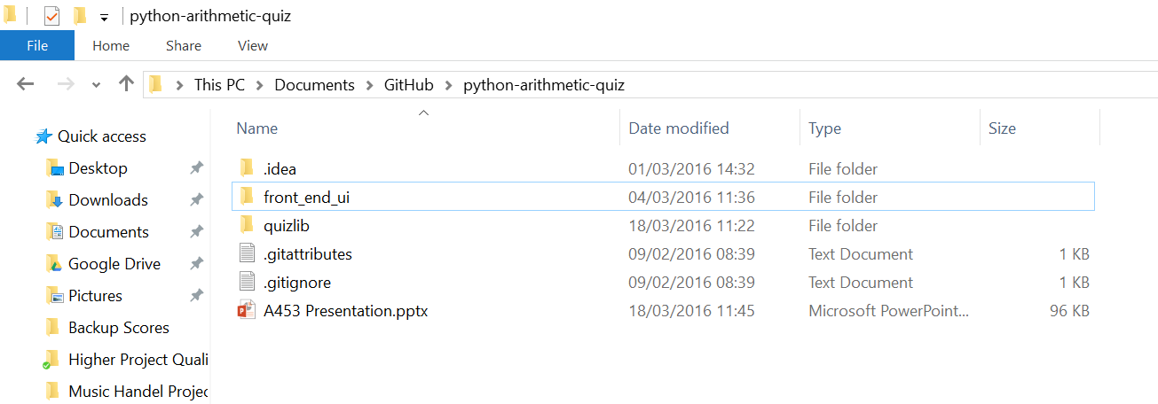
Initial Setup Testing
To the right is the project folder without any save data yet. This will test whether the program can create the initial data structure.

Slide 19
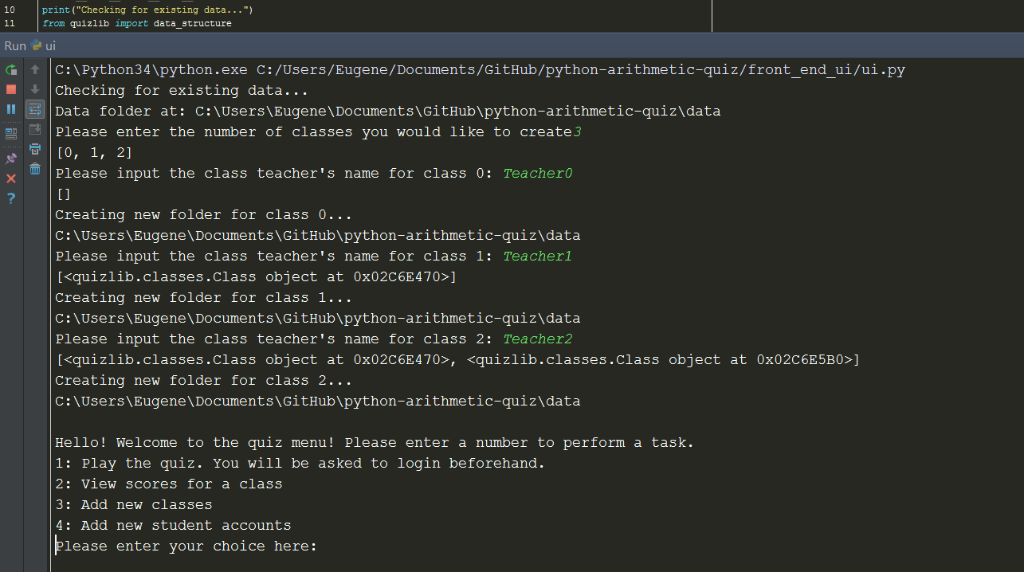
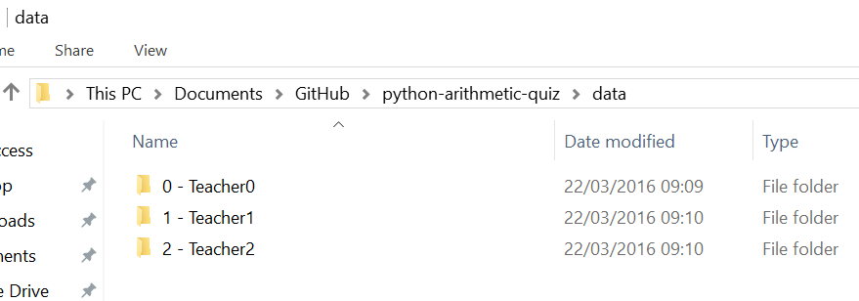
Initial file setup
The program recognises that there is no data setup, hence asks for new classes to be created. Class IDs are automatically generated, all that is asked is the class teacher’s name. The screenshot shows three classes being created, as per specification.
The second screenshot shows that the data folder has been created, and that the classes now are represented on disk as folders.

Slide 20
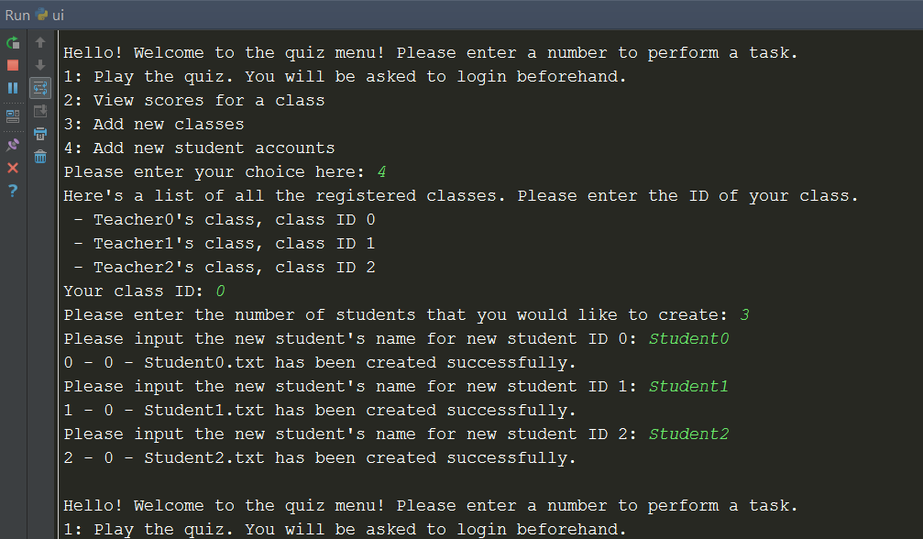
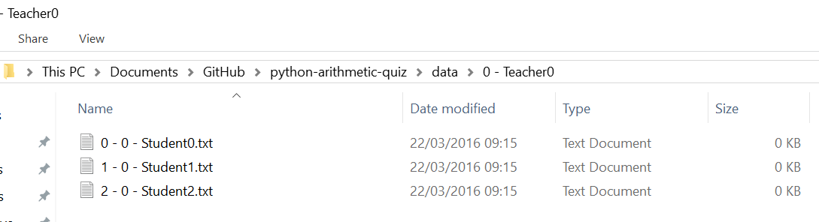
Student File Setup
The following screenshot shows the creation of 3 test student accounts within Class 0.
The screenshot below shows that these have now been represented using 1 text file per student.

Slide 21
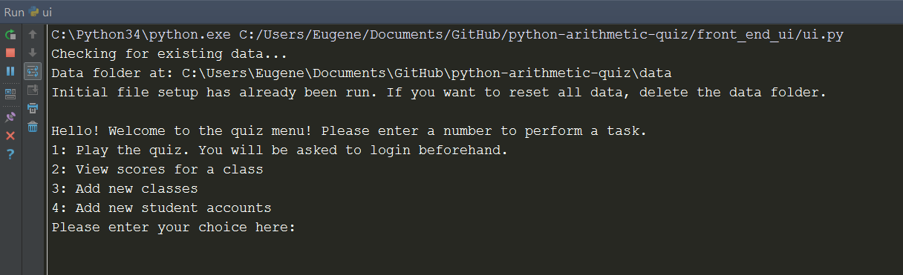
Running the program after file setup
The following screenshot shows that the program now recognises that there is an existing data structure, and does not try to create a new one.

Slide 22
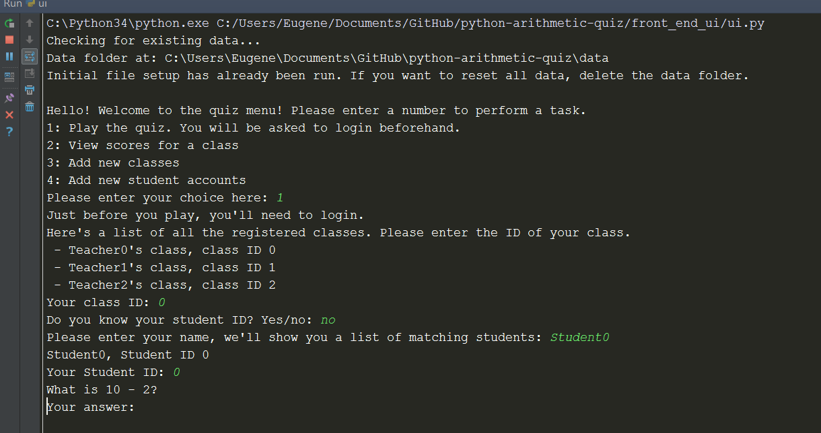
Quiz Login
The following screenshot demonstrates the login function of the program. The student is asked to login using their ID, and if they do not know their ID, they can use a name search function to find and then enter their ID.

Slide 23
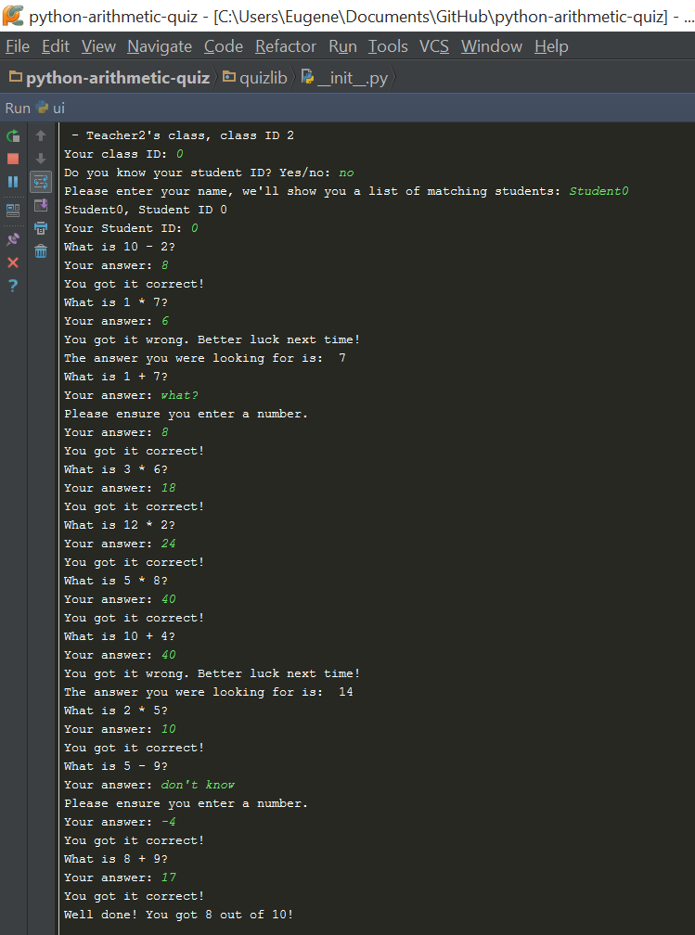
Quiz Participation
The following screenshot shows 3 scenarios:
The player got the answer right
They are congratulated
The player got the answer wrong
They are told the right answer
The player provided invalid input
They are told to re-input their answer
Finally, the user is shown their score.
Note that 10 questions are asked, not including repeats due to invalid input.
Note that the program shows how much they scored out of 10.
Note that the program uses 2 random numbers from 1 to 12 for the questions.

Slide 24
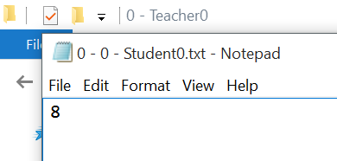



Saving data in the student file
Note that the previous quiz returned a score of 8. This can now be seen in the first screenshot.
Note that when the quiz is played by the same person multiple times their score is added to their file.
Note that on the 4th time, the first score is discarded – I.e. keeping only the last 3 scores.

Slide 25
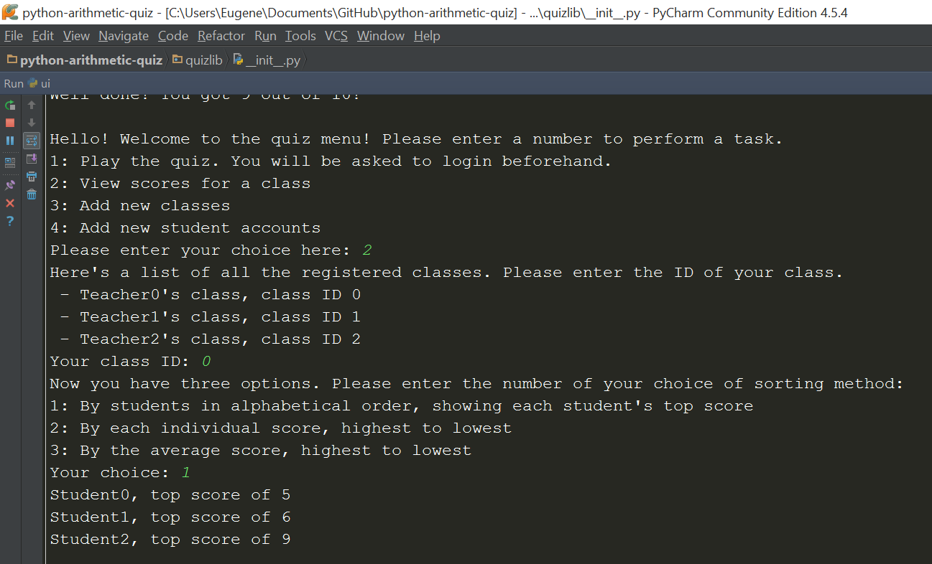
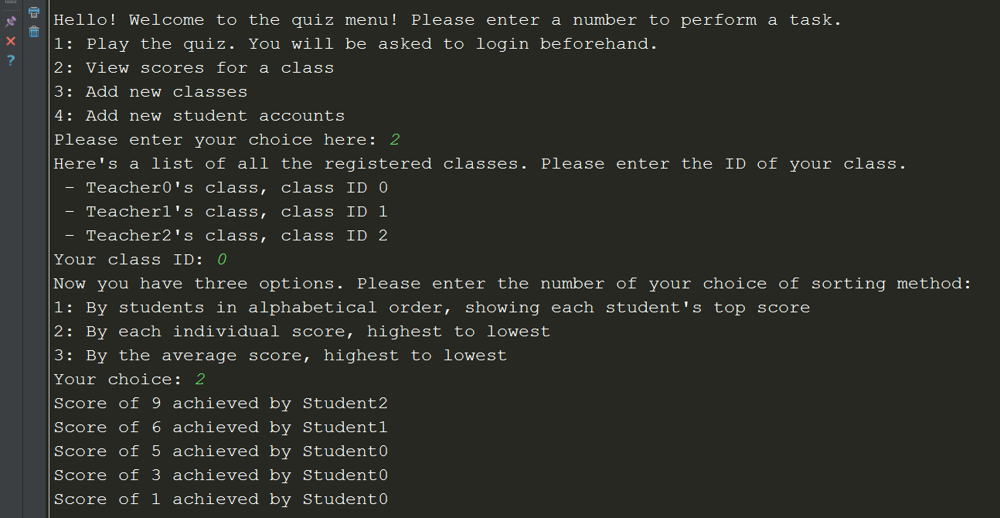
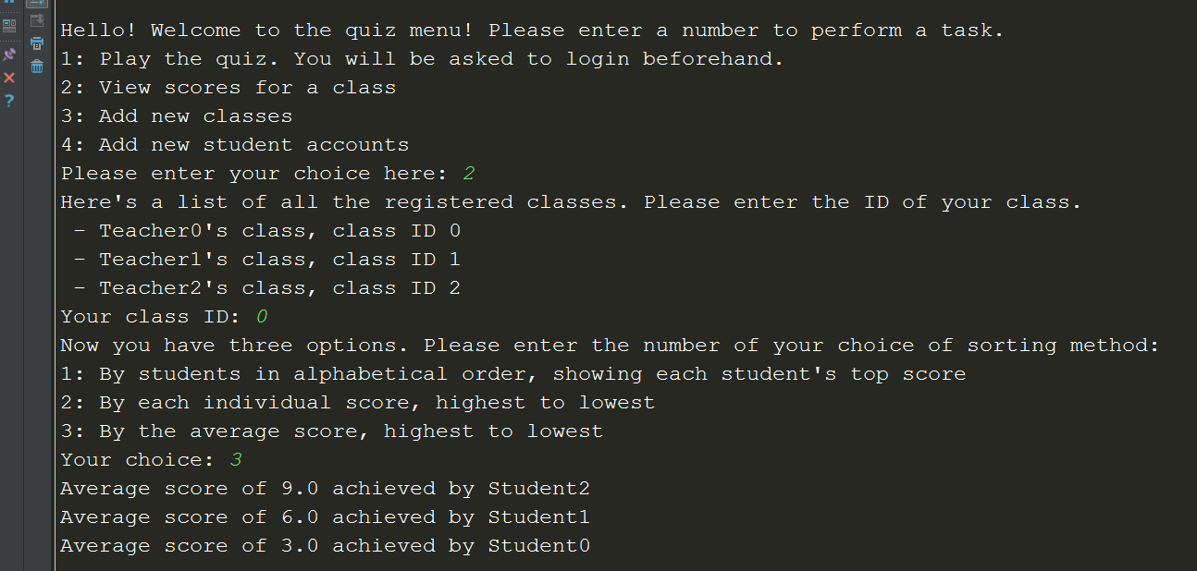
Sorting
The program asks for which class to show data for.
The program asks for a sorting method choice.
The program then prints out the data in an organized format.

Slide 26
Evaluation
I ended up making full use of the programming techniques which I had described in the introduction. I would say that the OOP constructs that I used necessitated some of these, especially functions which would be needed to define object methods.
Throughout, I have followed the PEP 8 coding conventions as closely as possible, and where I haven’t there is a reason not to. This is facilitated by PyCharm’s real-time PEP checking. For example, PEP 8 specifies that I should not make a line longer than 127 characters, however where I have exceeded this, I have only exceeded it by a few characters, where otherwise continuing the line on to the next would require a reworking of the code disproportionate to accommodating a couple extra characters.
In addition, I have tried to make my code as self-descriptive as possible, with properly named functions and variables playing a large part of this. This means that my code is more easily understandable, as well as comments only having to describe the overall function of a section of code, as opposed to being needed to explain every nook and cranny of a method – sign that there is probably a better, more concise solution.

